Slide 1
BIKE RENTAL PREDICTION
R Programming

Slide 2
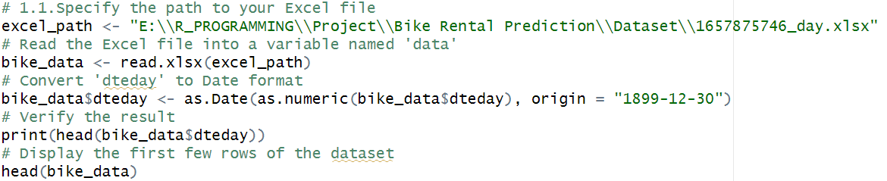
1. Exploratory data analysis • Load dataset and libraries

Slide 3
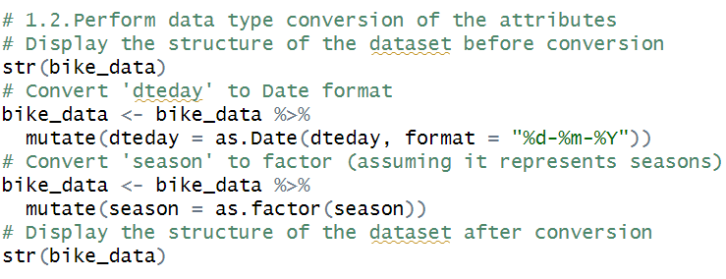
• Perform data type conversion of the attributes

Slide 4
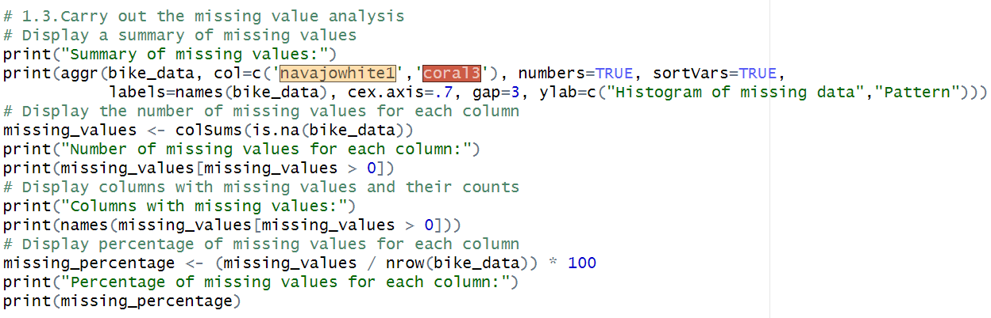
• Carry out the missing value analysis

Slide 5
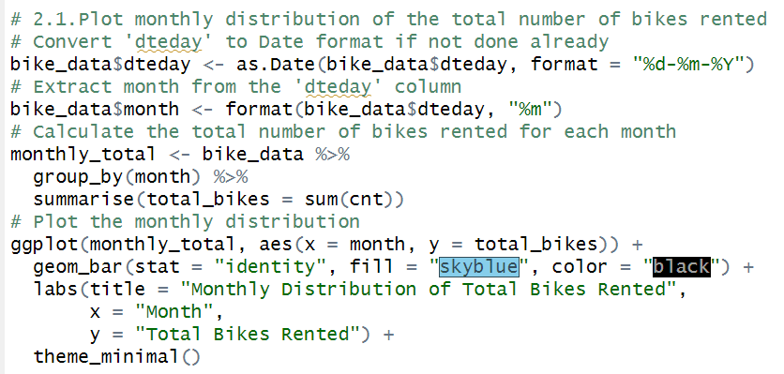
2. Attributes distributions and trends • Plot monthly distribution of the total number of bikes rented

Slide 6
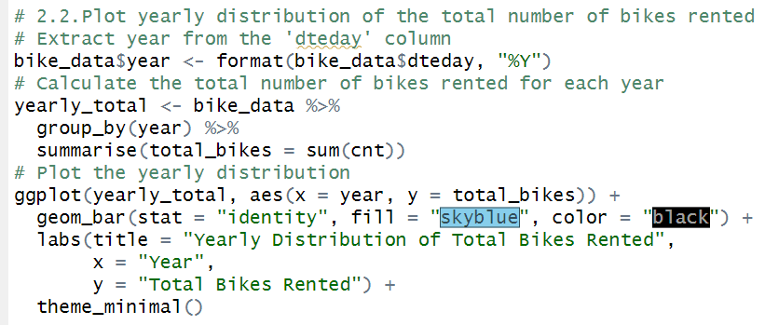
• Plot yearly distribution of the total number of bikes rented

Slide 7
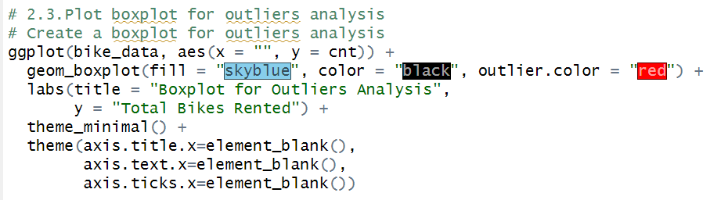
• Plot boxplot for outliers analysis

Slide 8
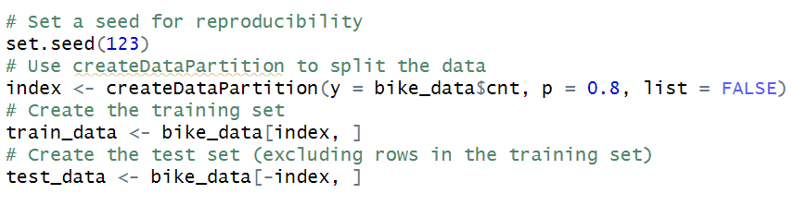
3. Split the dataset into train and test dataset

Slide 9
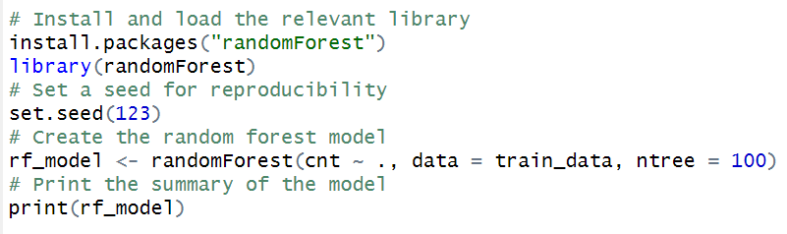
4. Create a model using the random forest algorithm

Slide 10
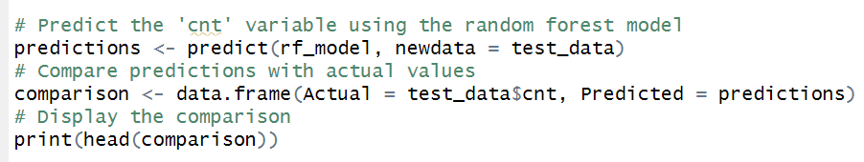
5. Predict the performance of the model on the test dataset

Slide 11
THANK YOU

